Slide 1
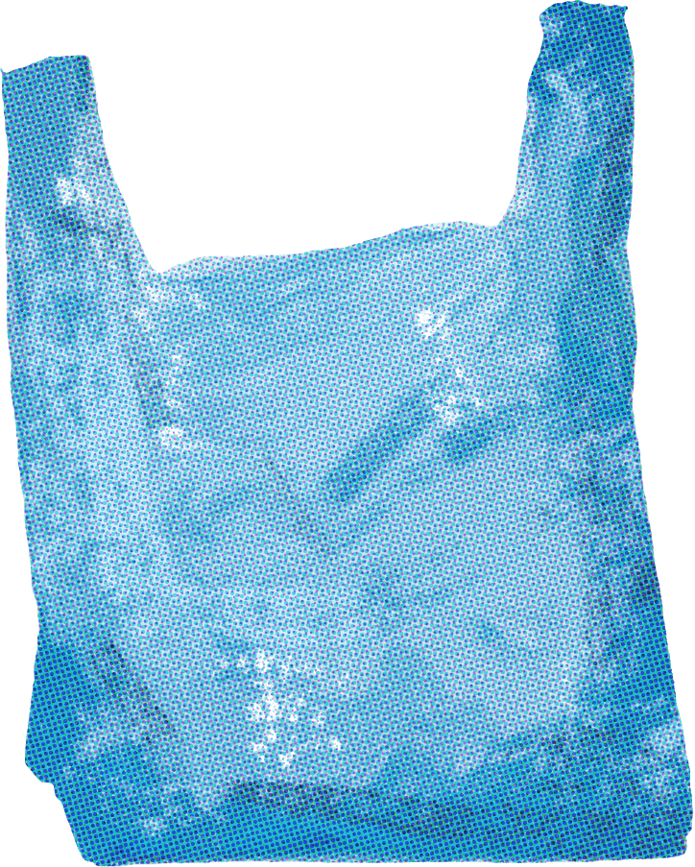
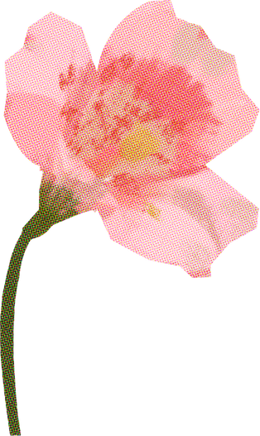
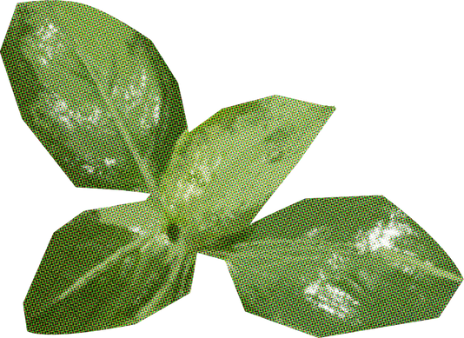

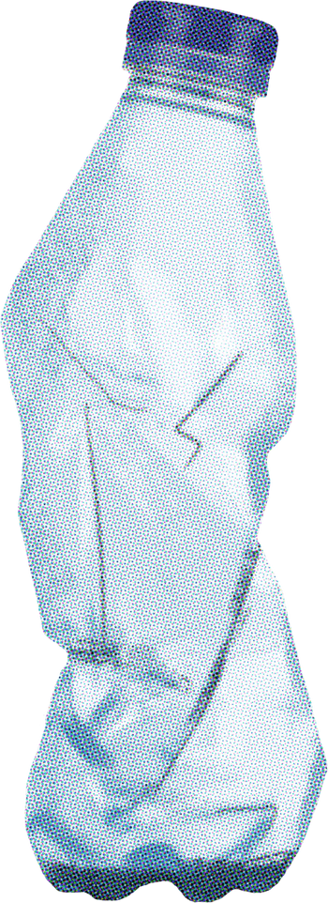
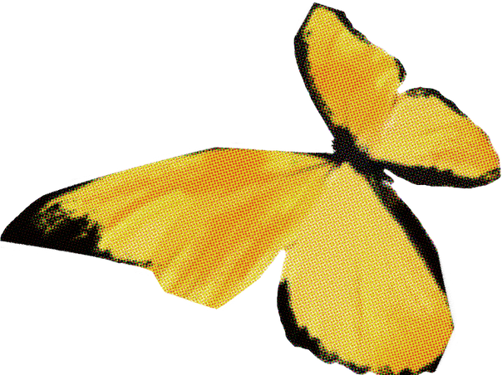
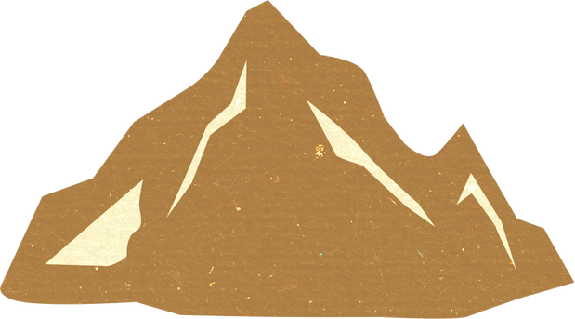
Waste Well: Plastic Recycling for a Better Future
ECOCYCLE
GREENLOOP

Slide 2

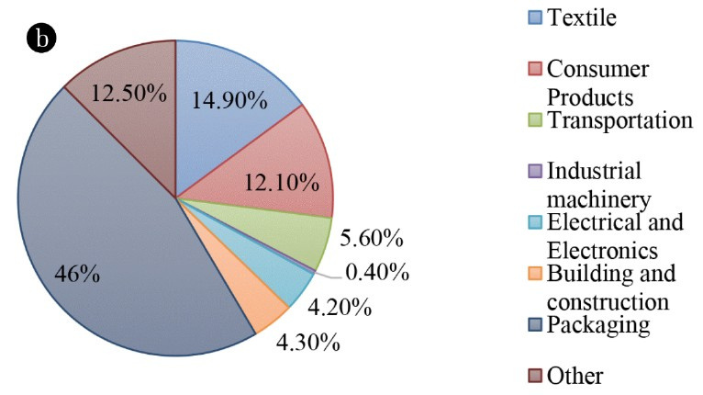




PROBLEM STATEMENT
Introduction
In Dhaka, about 646 tonnes of plastic
waste are collected daily -
this is ~10% of the city’s total waste. the daily observer
Nationwide: ~21% of single‐use bottles recycled; ~79% mismanaged.
This data shows a critical gap between plastic consumption and sustainable disposal. It highlights strong need for improved collection, recycling and reduction of single‐use plastics.

Slide 3
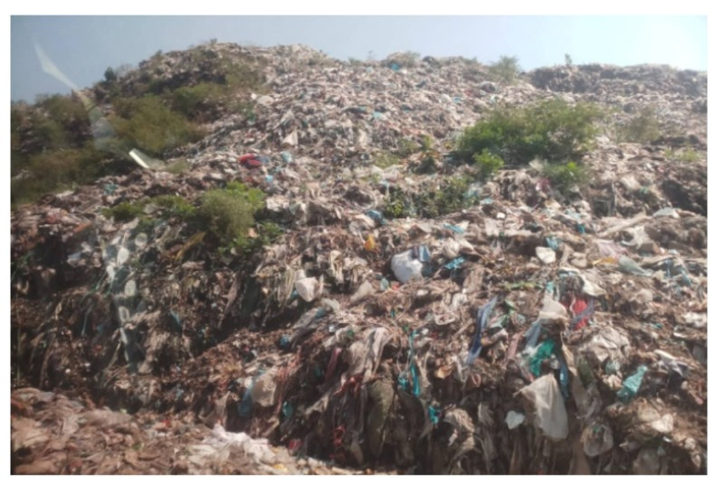
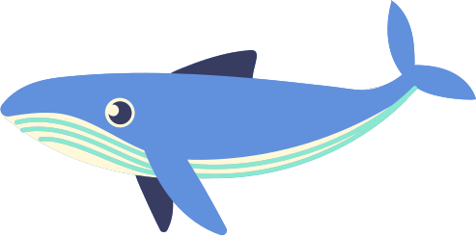
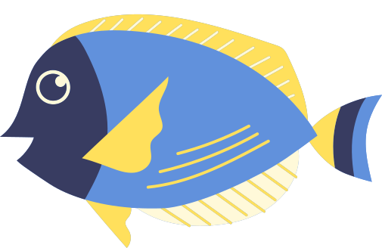


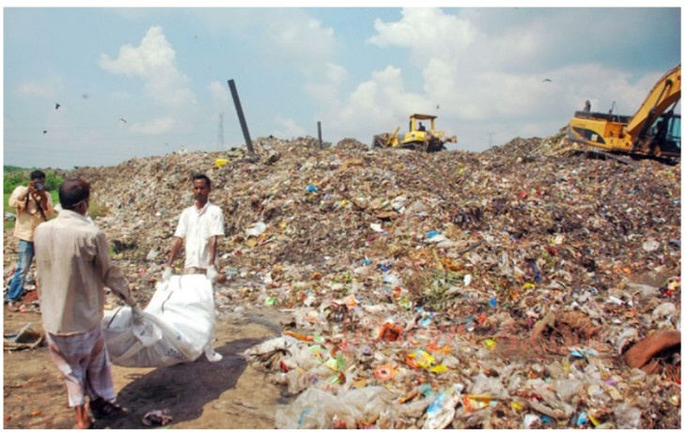


Challenges:
1. Poor Waste Segregation:
Most households mix all waste together → lowers recycling quality.
2. Limited Collection Infrastructure:
City corporations lack enough trucks, bins, and manpower.
3. High Transport & Processing Costs:
Moving waste to recycling plants is expensive; small startups can’t afford it.
4. Informal Recycling System:
Waste pickers work in unsafe conditions with no recognition or fair pay.
Dumping Station at Mauli,Dhaka
Develop recycling technology.
Dumping Station At Halishahar,Chottogram

Slide 4
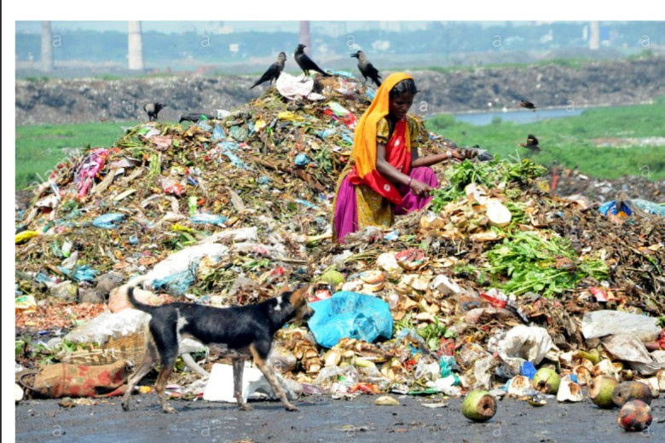
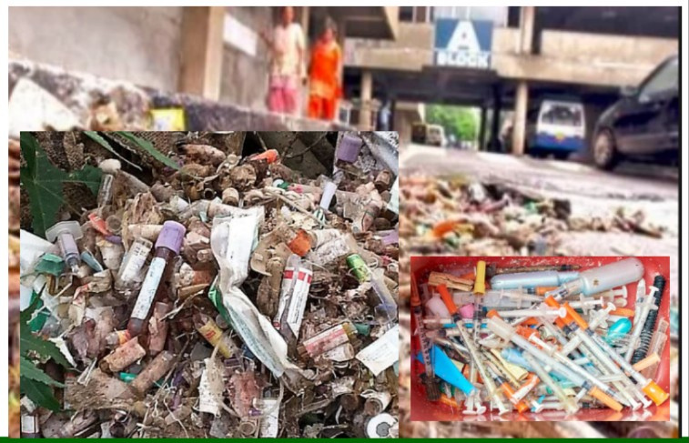
Challenges :
5. Low Public Awareness:
People don’t know the value of recycling or how to separate plastics.
6. Lack of Policy Support & Incentives:
Few government incentives for green businesses or waste segregation.
7. Poor Market for Recycled Products:
Recycled materials often seen as “low quality,” reducing buyer interest.
8. Financial & Technical Barriers:
Limited funding, modern equipment, and innovation in recycling sector.

Slide 5
LIST OF CONTENTS
LIST OF CONTENTS
Introduction
The Importance of Marine Conservation
Plastic Pollution
Marine Conservation Efforts
Our Role in Marine Conservation
Conclusion

Slide 6
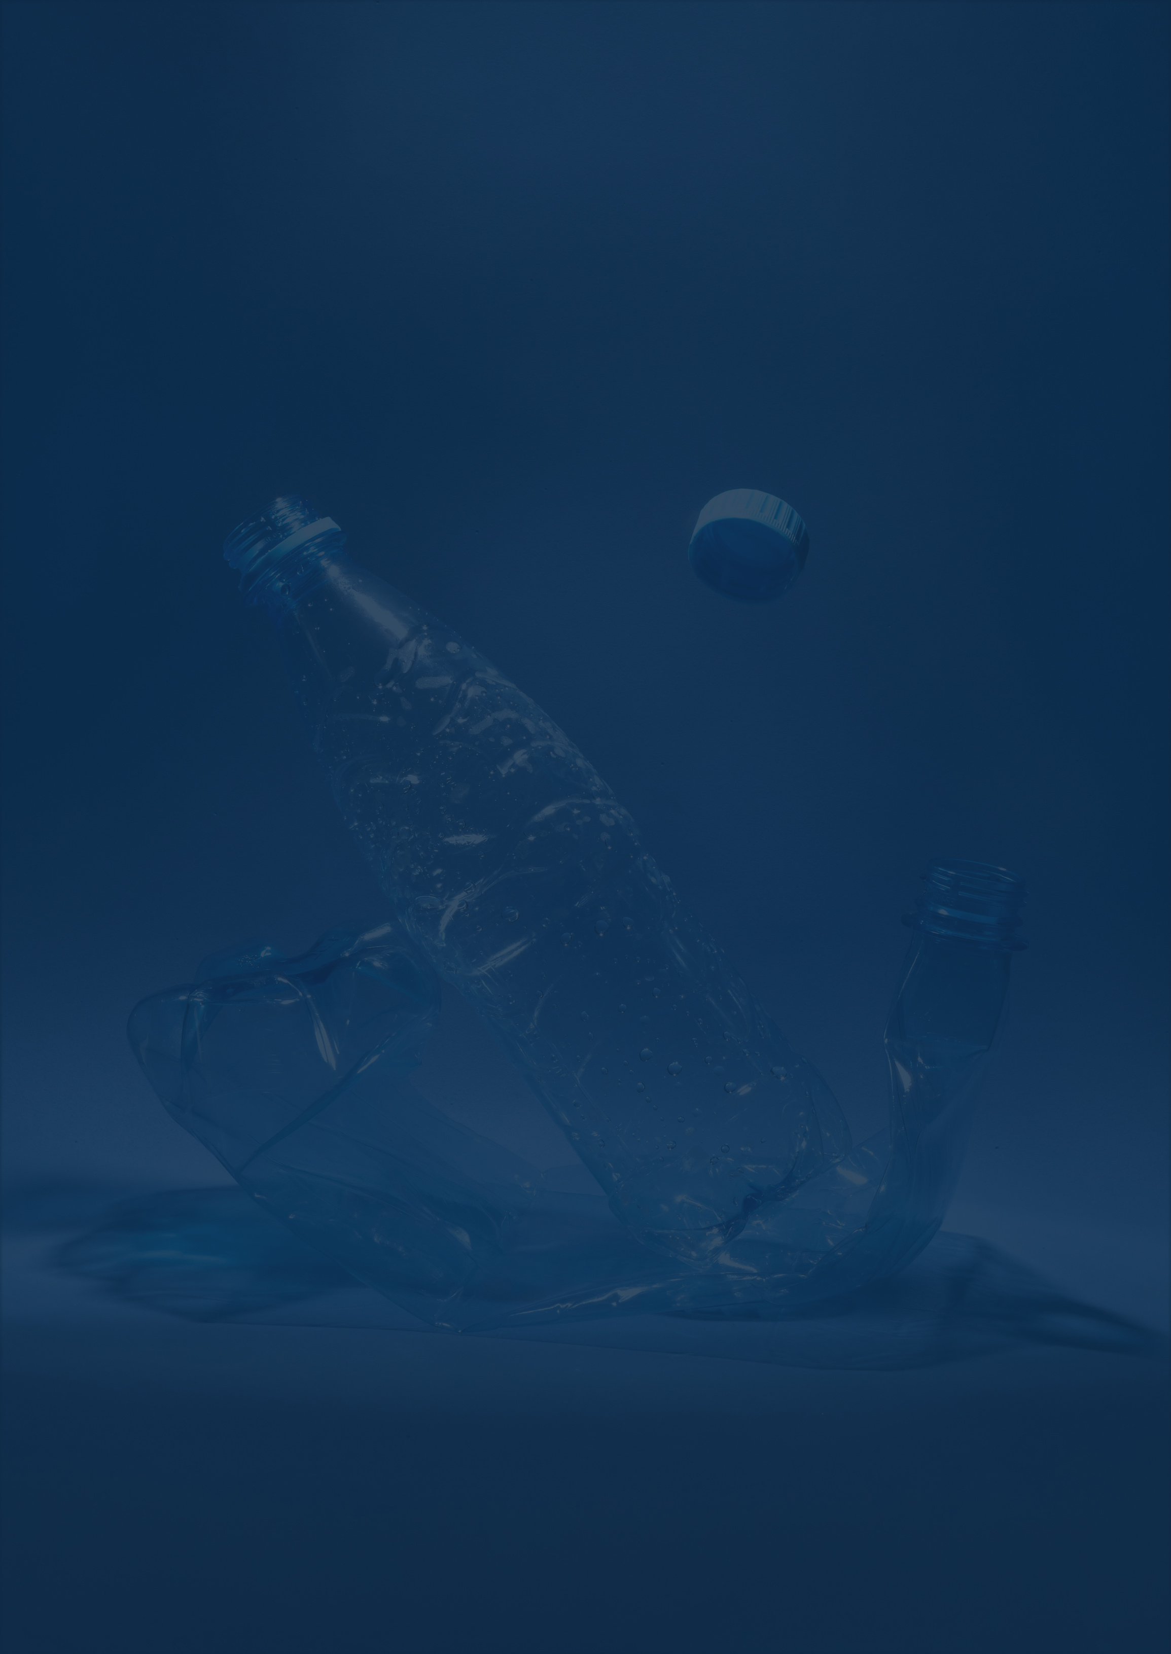

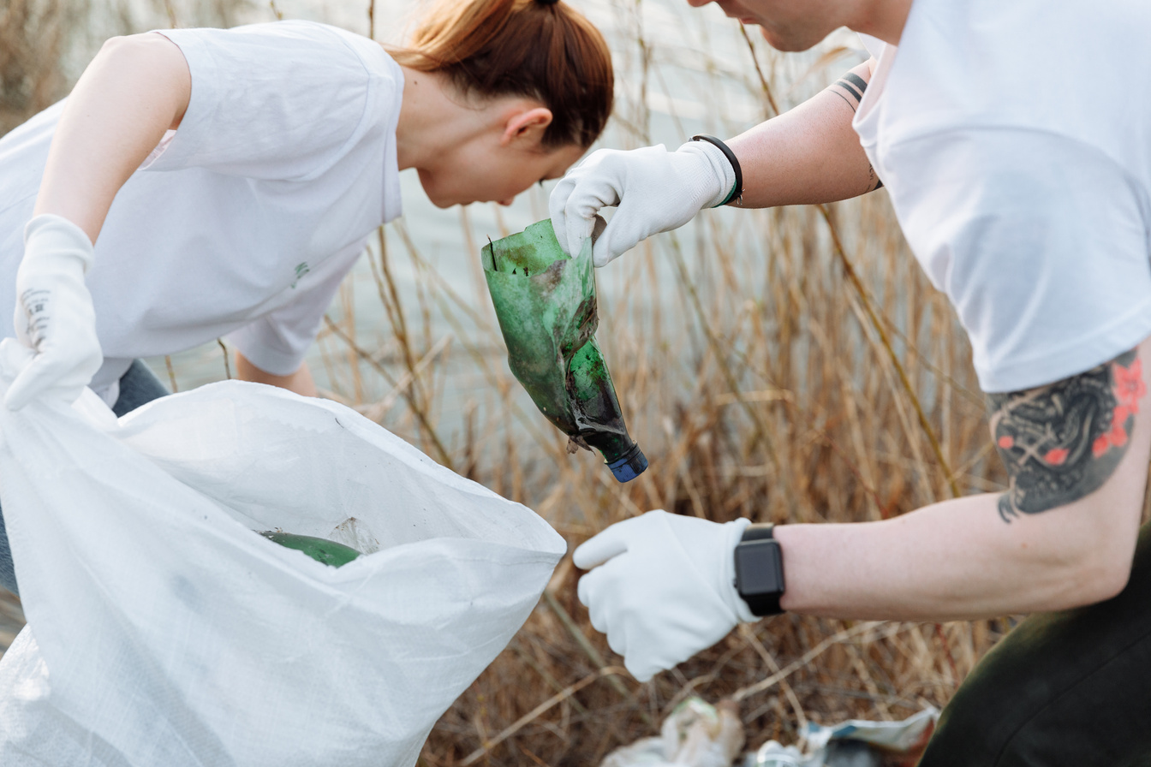
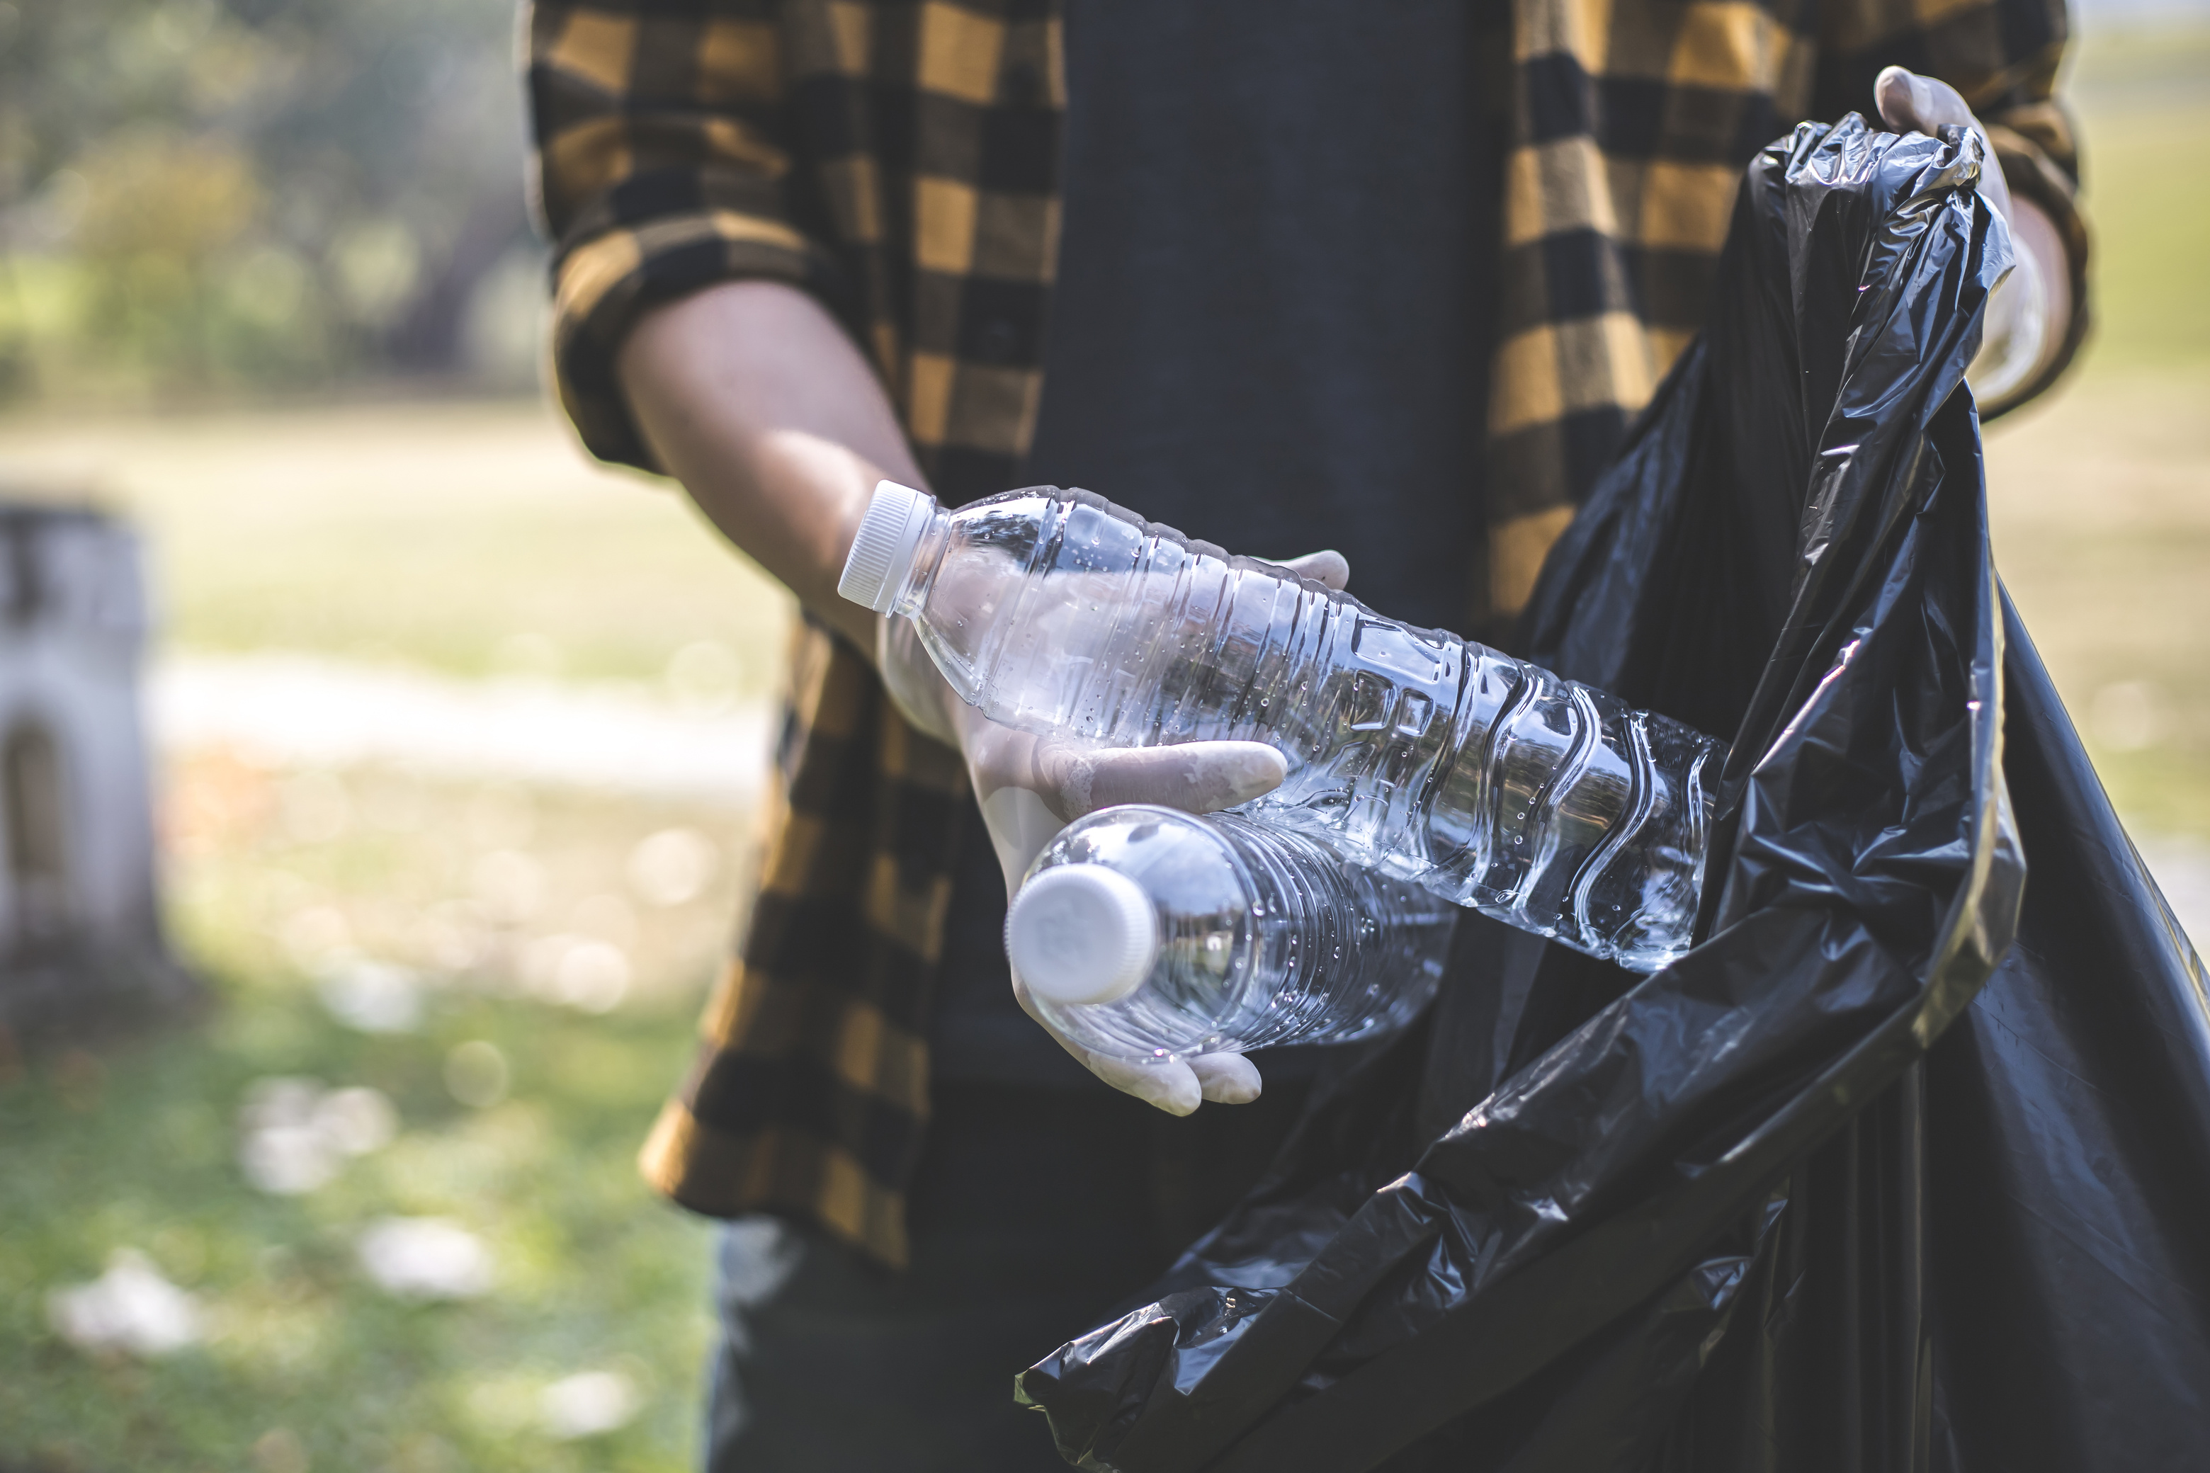
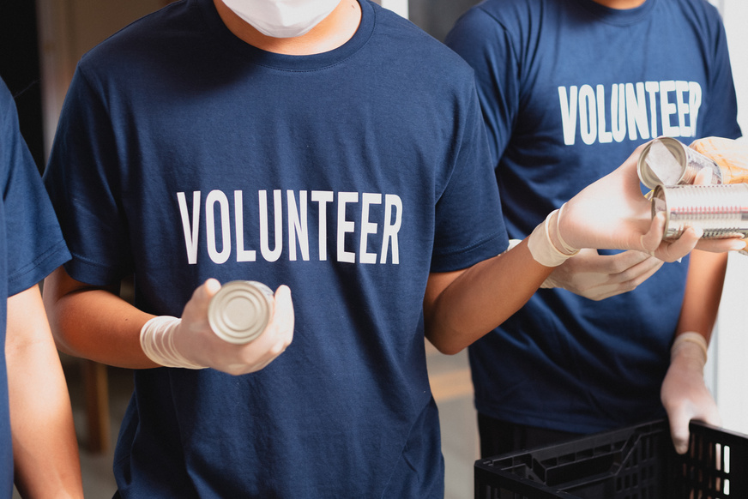
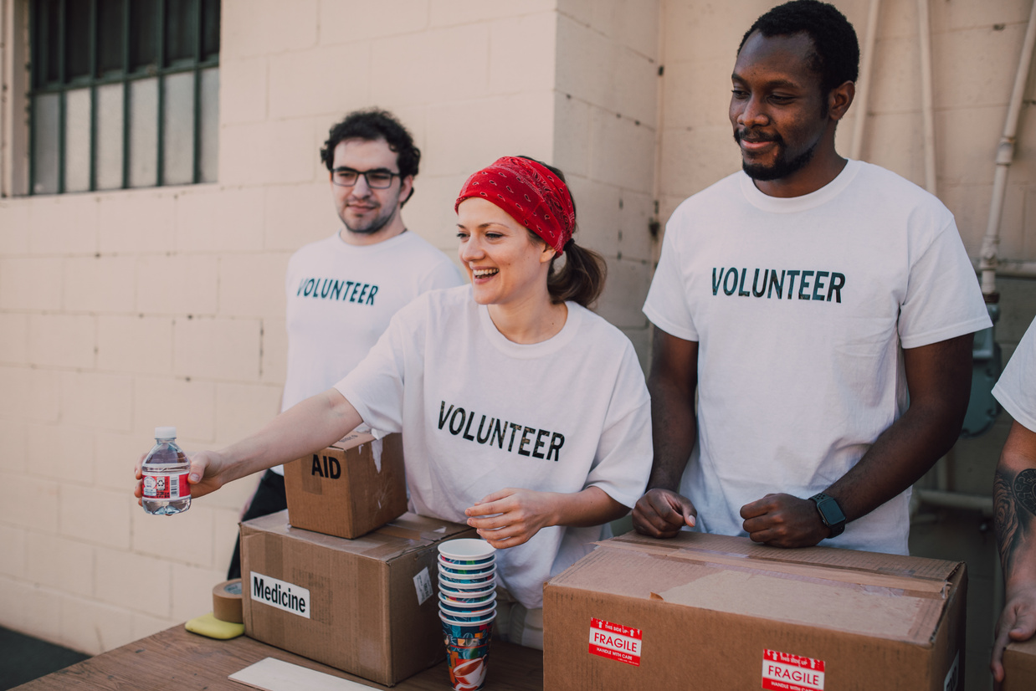
LICERIA & CO.
UNITED AGAINST MICROPLASTICS
POLICY MEASURES
STRONG INTERNATIONAL REGULATIONS MUST LIMIT PLASTIC PRODUCTION, PROMOTE ALTERNATIVES, AND ENFORCE RESPONSIBLE WASTE DISPOSAL PRACTICES TO PROTECT SHARED RESOURCES AND REDUCE POLLUTION.
Global Call to Action
AWARENESS CAMPAIGNS
PUBLIC EDUCATION HELPS COMMUNITIES UNDERSTAND RISKS, PROMOTING BEHAVIOR CHANGES LIKE REUSING, RECYCLING, AND CHOOSING SUSTAINABLE PRODUCTS TO FIGHT PLASTIC WASTE.
SHARED EFFORT
GOVERNMENTS, INDUSTRIES, AND INDIVIDUALS SHARE RESPONSIBILITY. ONLY COLLECTIVE ACTION CAN BREAK DEPENDENCE ON PLASTICS AND ADDRESS MICROPLASTIC POLLUTION EFFECTIVELY ACROSS NATIONS AND GENERATIONS.

Slide 7
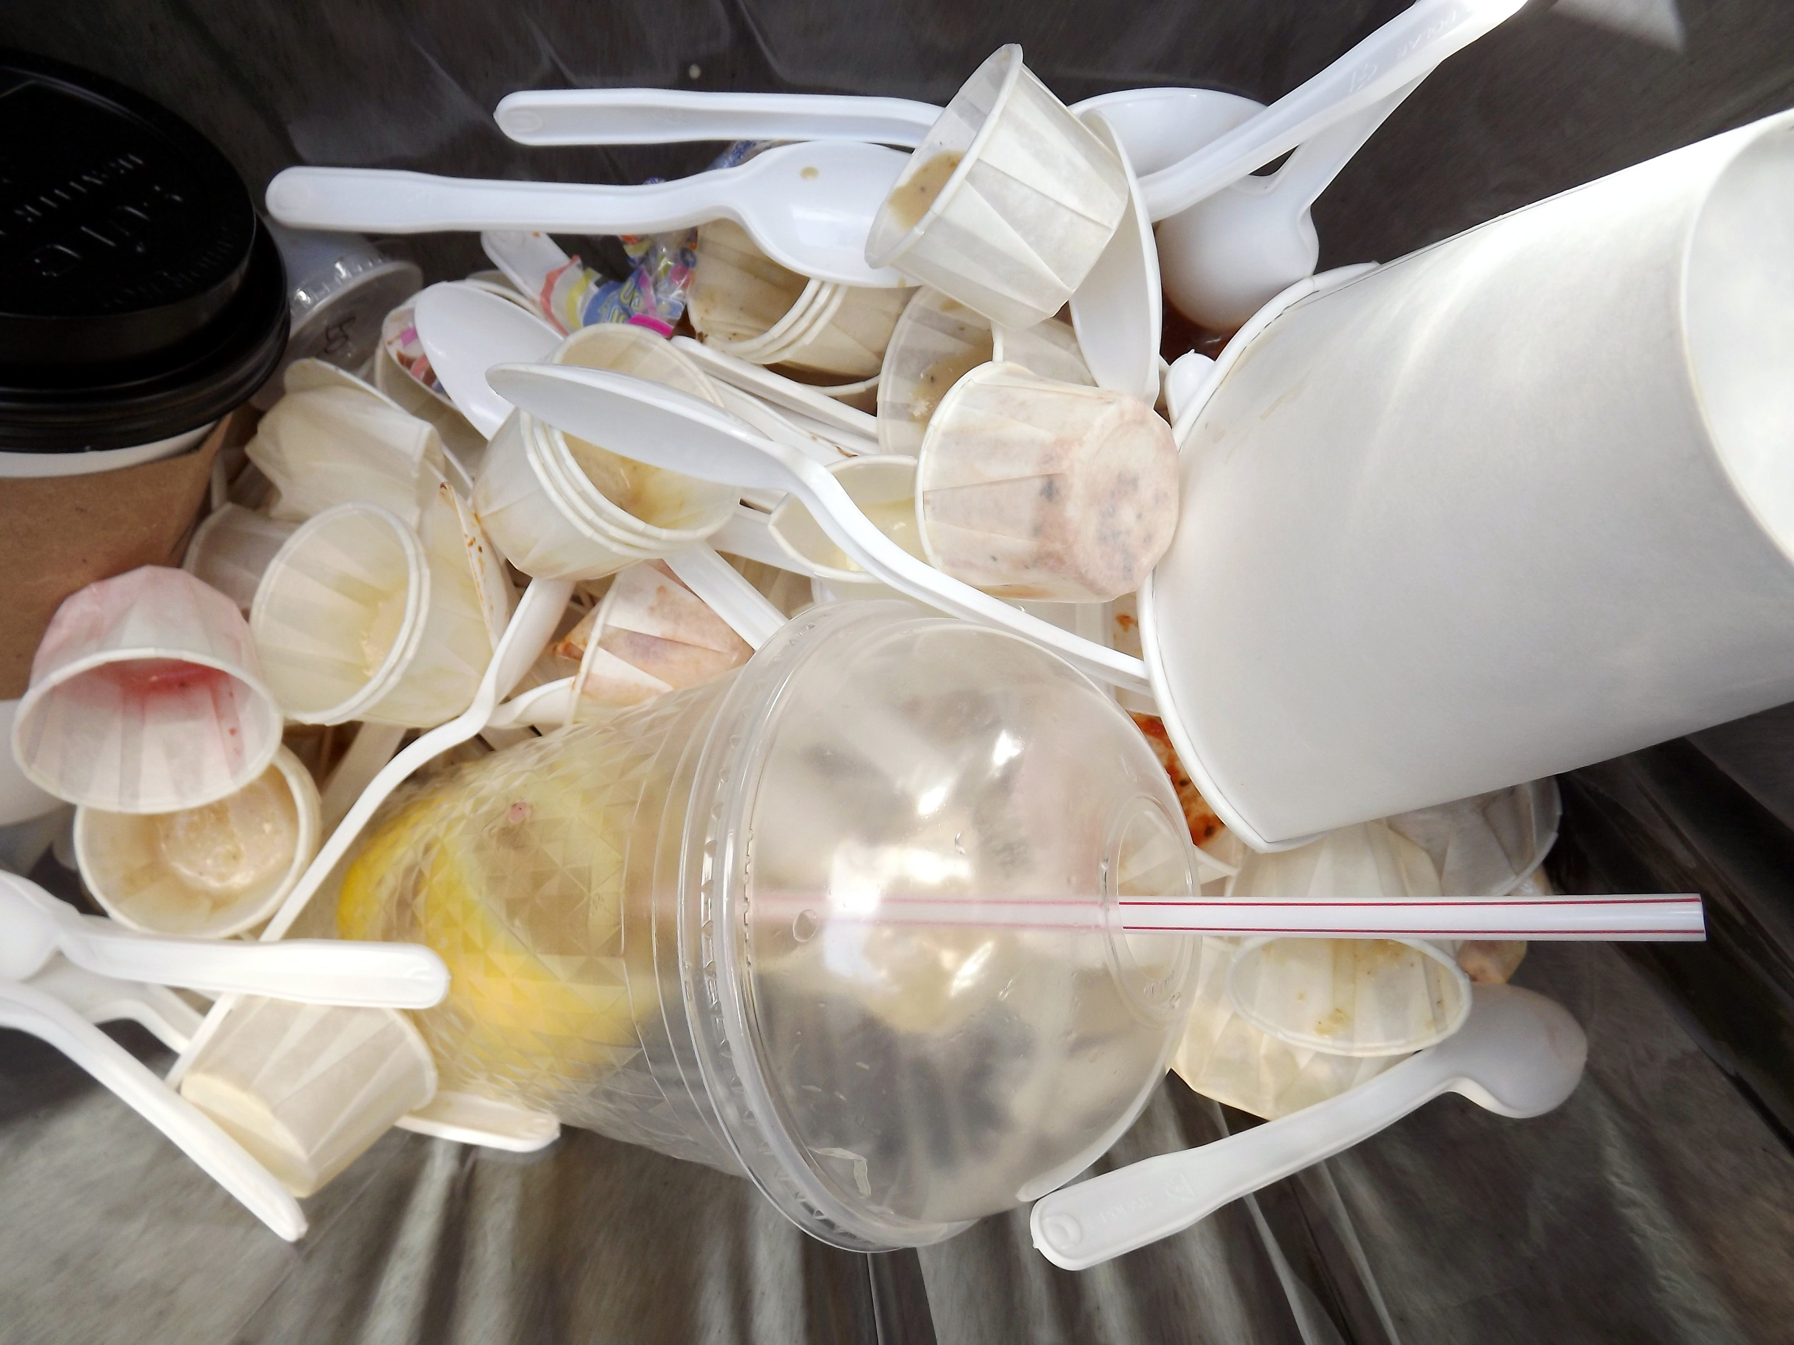
Reducing the Spread
LICERIA & CO.
PRACTICAL STEPS TO PREVENTION
PLASTIC REDUCTION
CHOOSE REUSABLE BAGS, REFILLABLE BOTTLES, AND ALTERNATIVES TO SINGLE-USE PRODUCTS, REDUCING DEMAND FOR DISPOSABLE PLASTICS IN DAILY CONSUMPTION PATTERNS WORLDWIDE.
WASTE SOLUTIONS
IMPROVE COLLECTION SYSTEMS, ENFORCE RECYCLING POLICIES, AND ENCOURAGE CIRCULAR ECONOMIES, REDUCING THE LEAKAGE OF PLASTICS INTO OCEANS AND SURROUNDING NATURAL ENVIRONMENTS GLOBALLY.

Slide 8
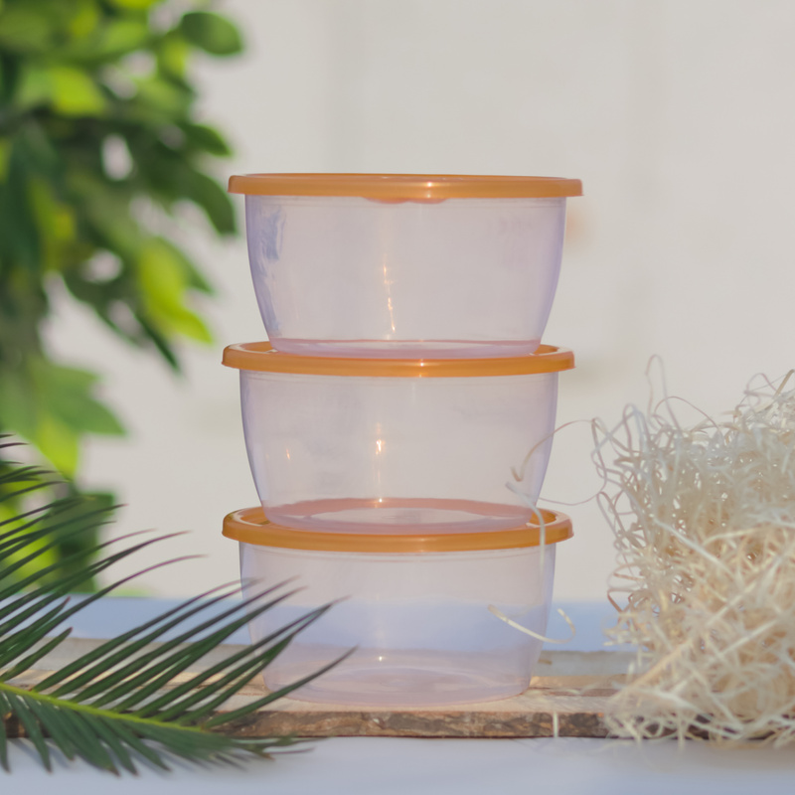
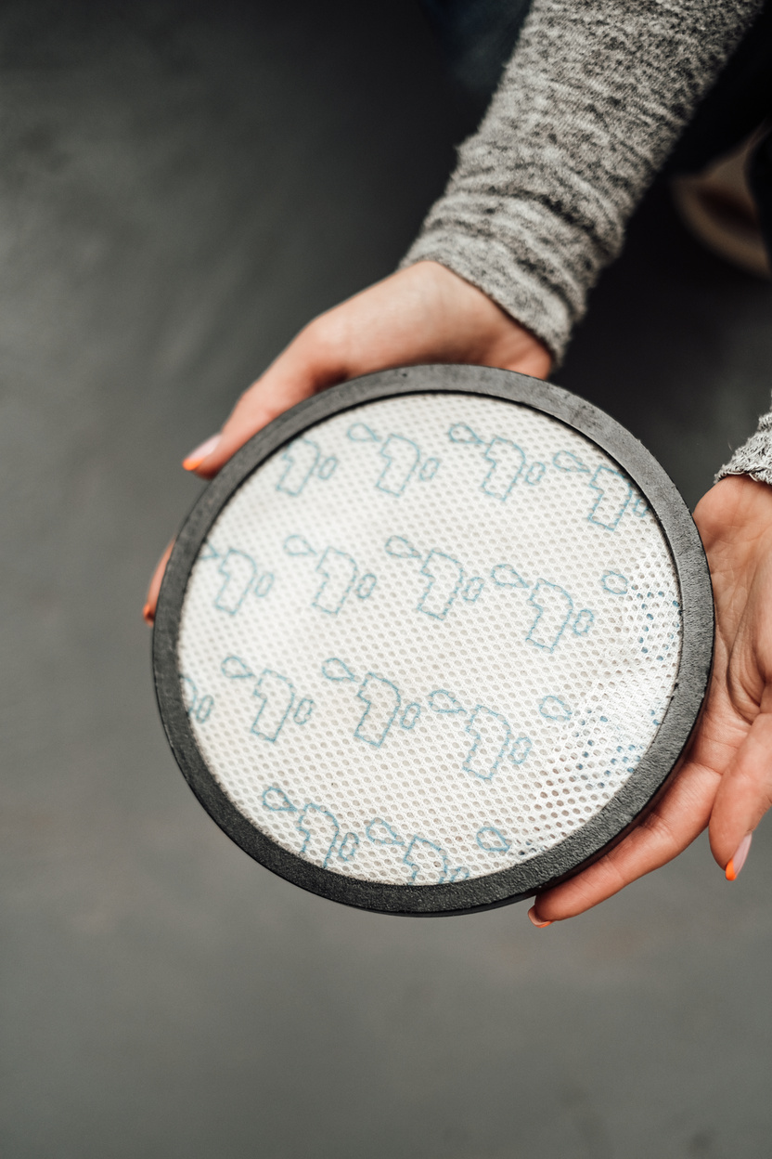
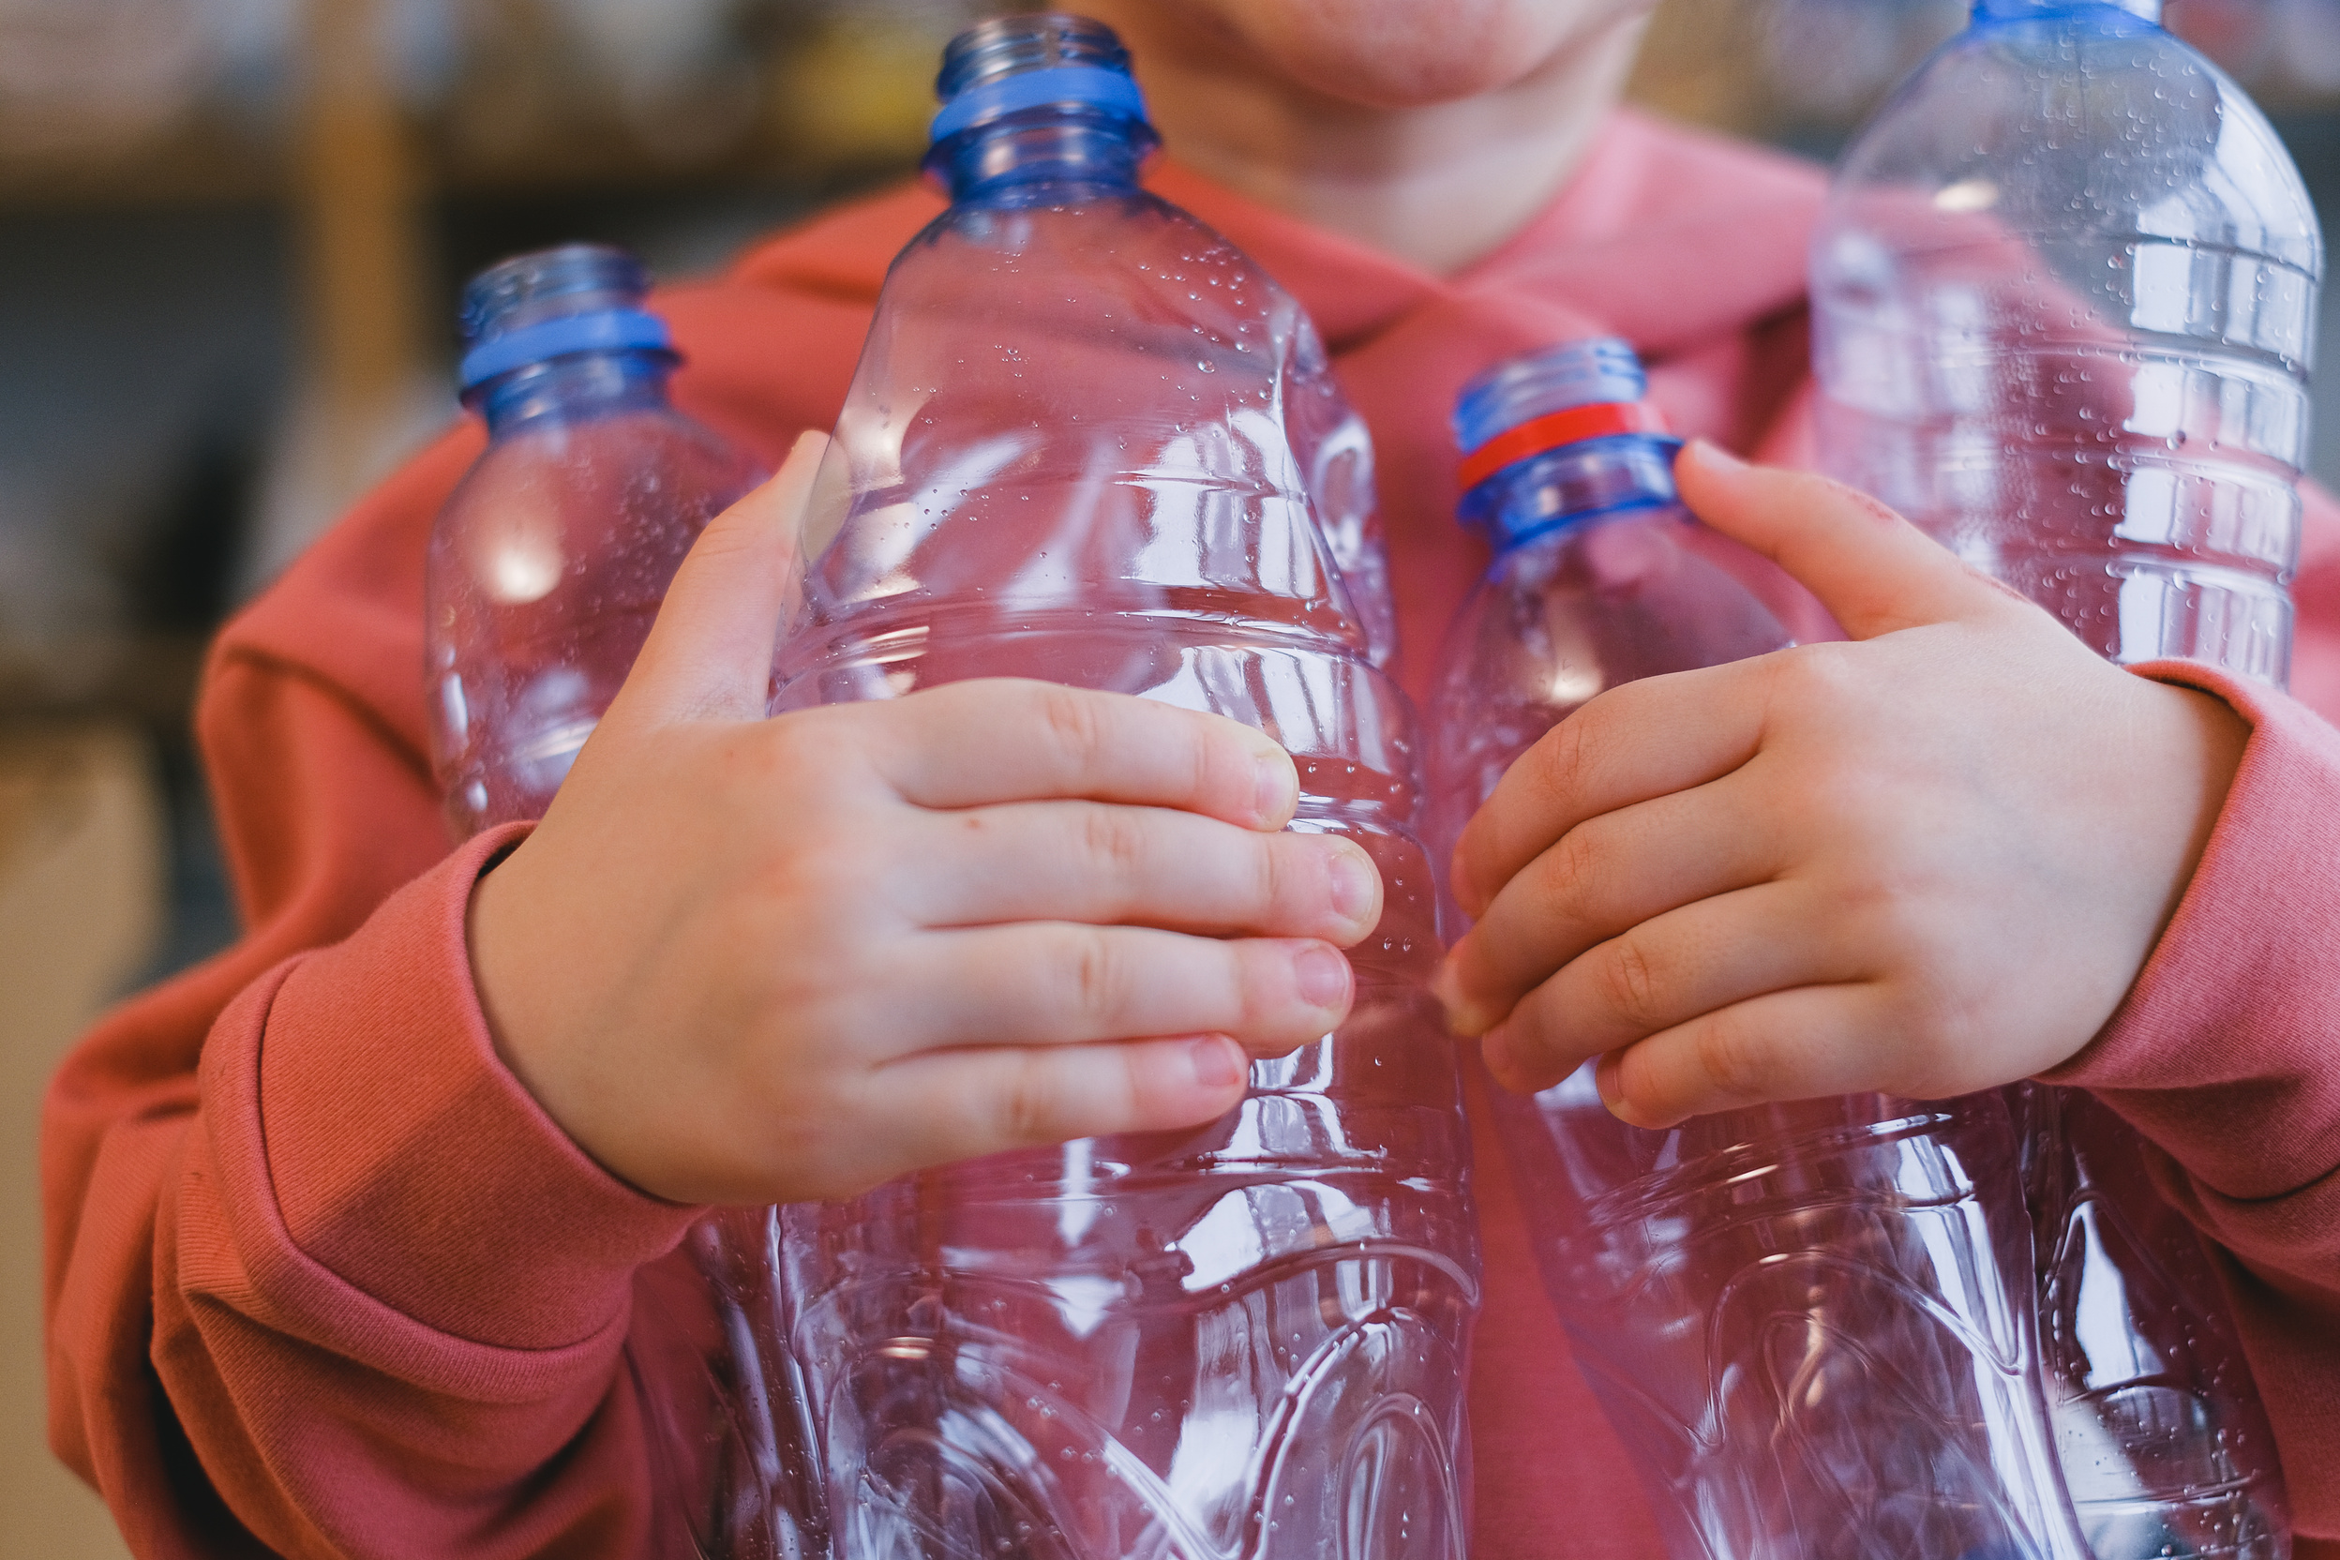
Innovative Solutions
LICERIA & CO.
TECHNOLOGY FIGHTING POLLUTION
SCIENTISTS ARE CREATING BIODEGRADABLE MATERIALS, EFFICIENT WASTE FILTERS, AND SUSTAINABLE PACKAGING. THESE SOLUTIONS AIM TO CUT DEPENDENCY ON SINGLE-USE PLASTICS AND STOP PARTICLES ESCAPING INTO ENVIRONMENTS. INNOVATIONS LIKE WASHING MACHINE FILTERS AND RIVER BARRIERS INTERCEPT MICROPLASTICS BEFORE REACHING SEAS, OFFERING HOPE FOR CLEANER ECOSYSTEMS AND HEALTHIER HUMAN POPULATIONS WORLDWIDE.

Slide 9
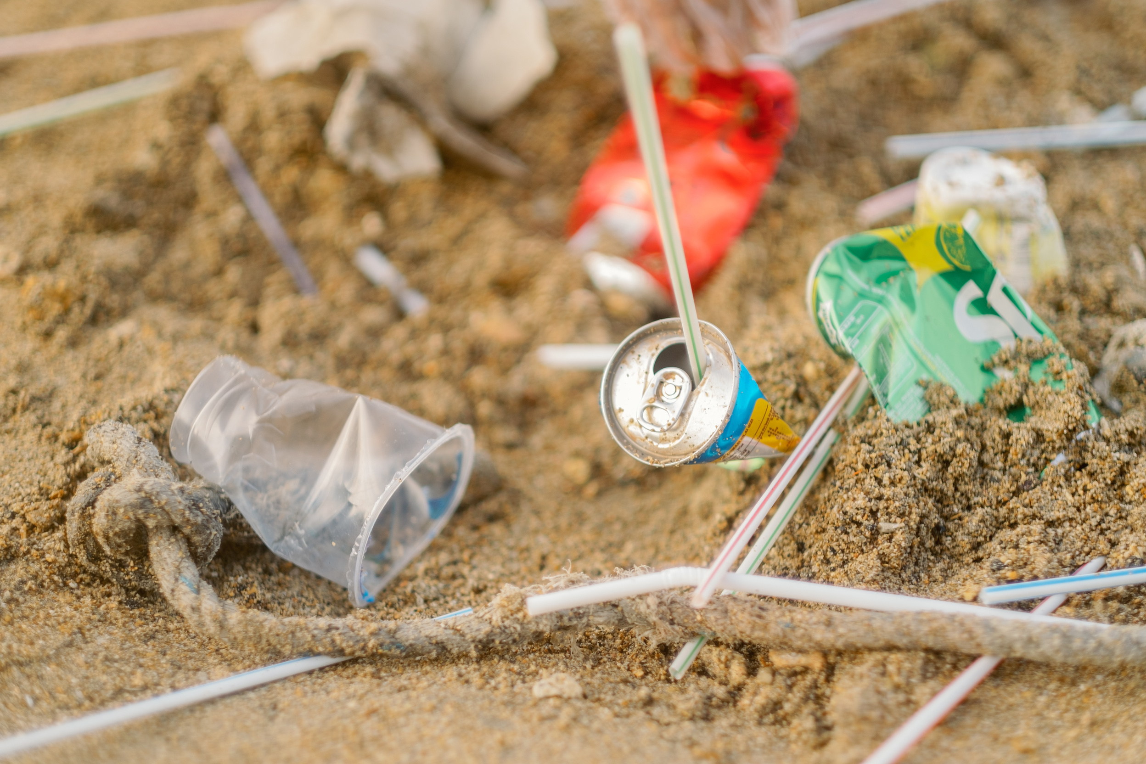
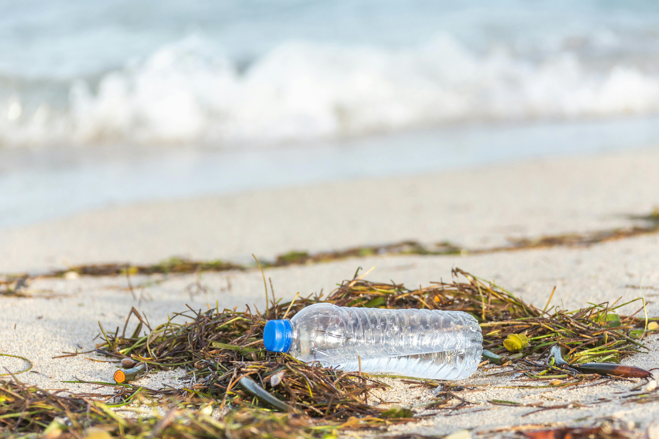
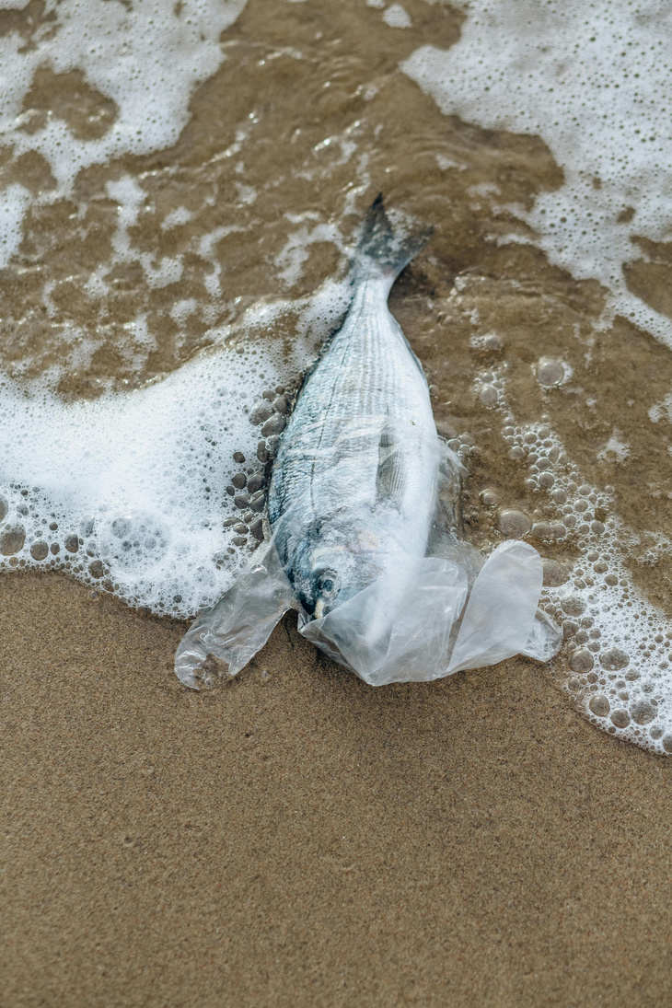
Environmental Consequences
THE CHAIN REACTION OF POLLUTION
LICERIA & CO.
MARINE THREATS
MARINE THREATS: FISH, BIRDS, AND MAMMALS UNKNOWINGLY CONSUME MICROPLASTICS. INGESTED PARTICLES ACCUMULATE INSIDE THEIR BODIES, IMPAIRING HEALTH, REPRODUCTION, AND SURVIVAL RATES ACROSS SPECIES.
ECOSYSTEM COLLAPSE
MICROPLASTICS MOVE UP FOOD CHAINS, WEAKENING BIODIVERSITY. HABITATS BECOME IMBALANCED, WITH DISRUPTED RELATIONSHIPS BETWEEN PREDATORS AND PREY, THREATENING ECOSYSTEMS WORLDWIDE.

Slide 10
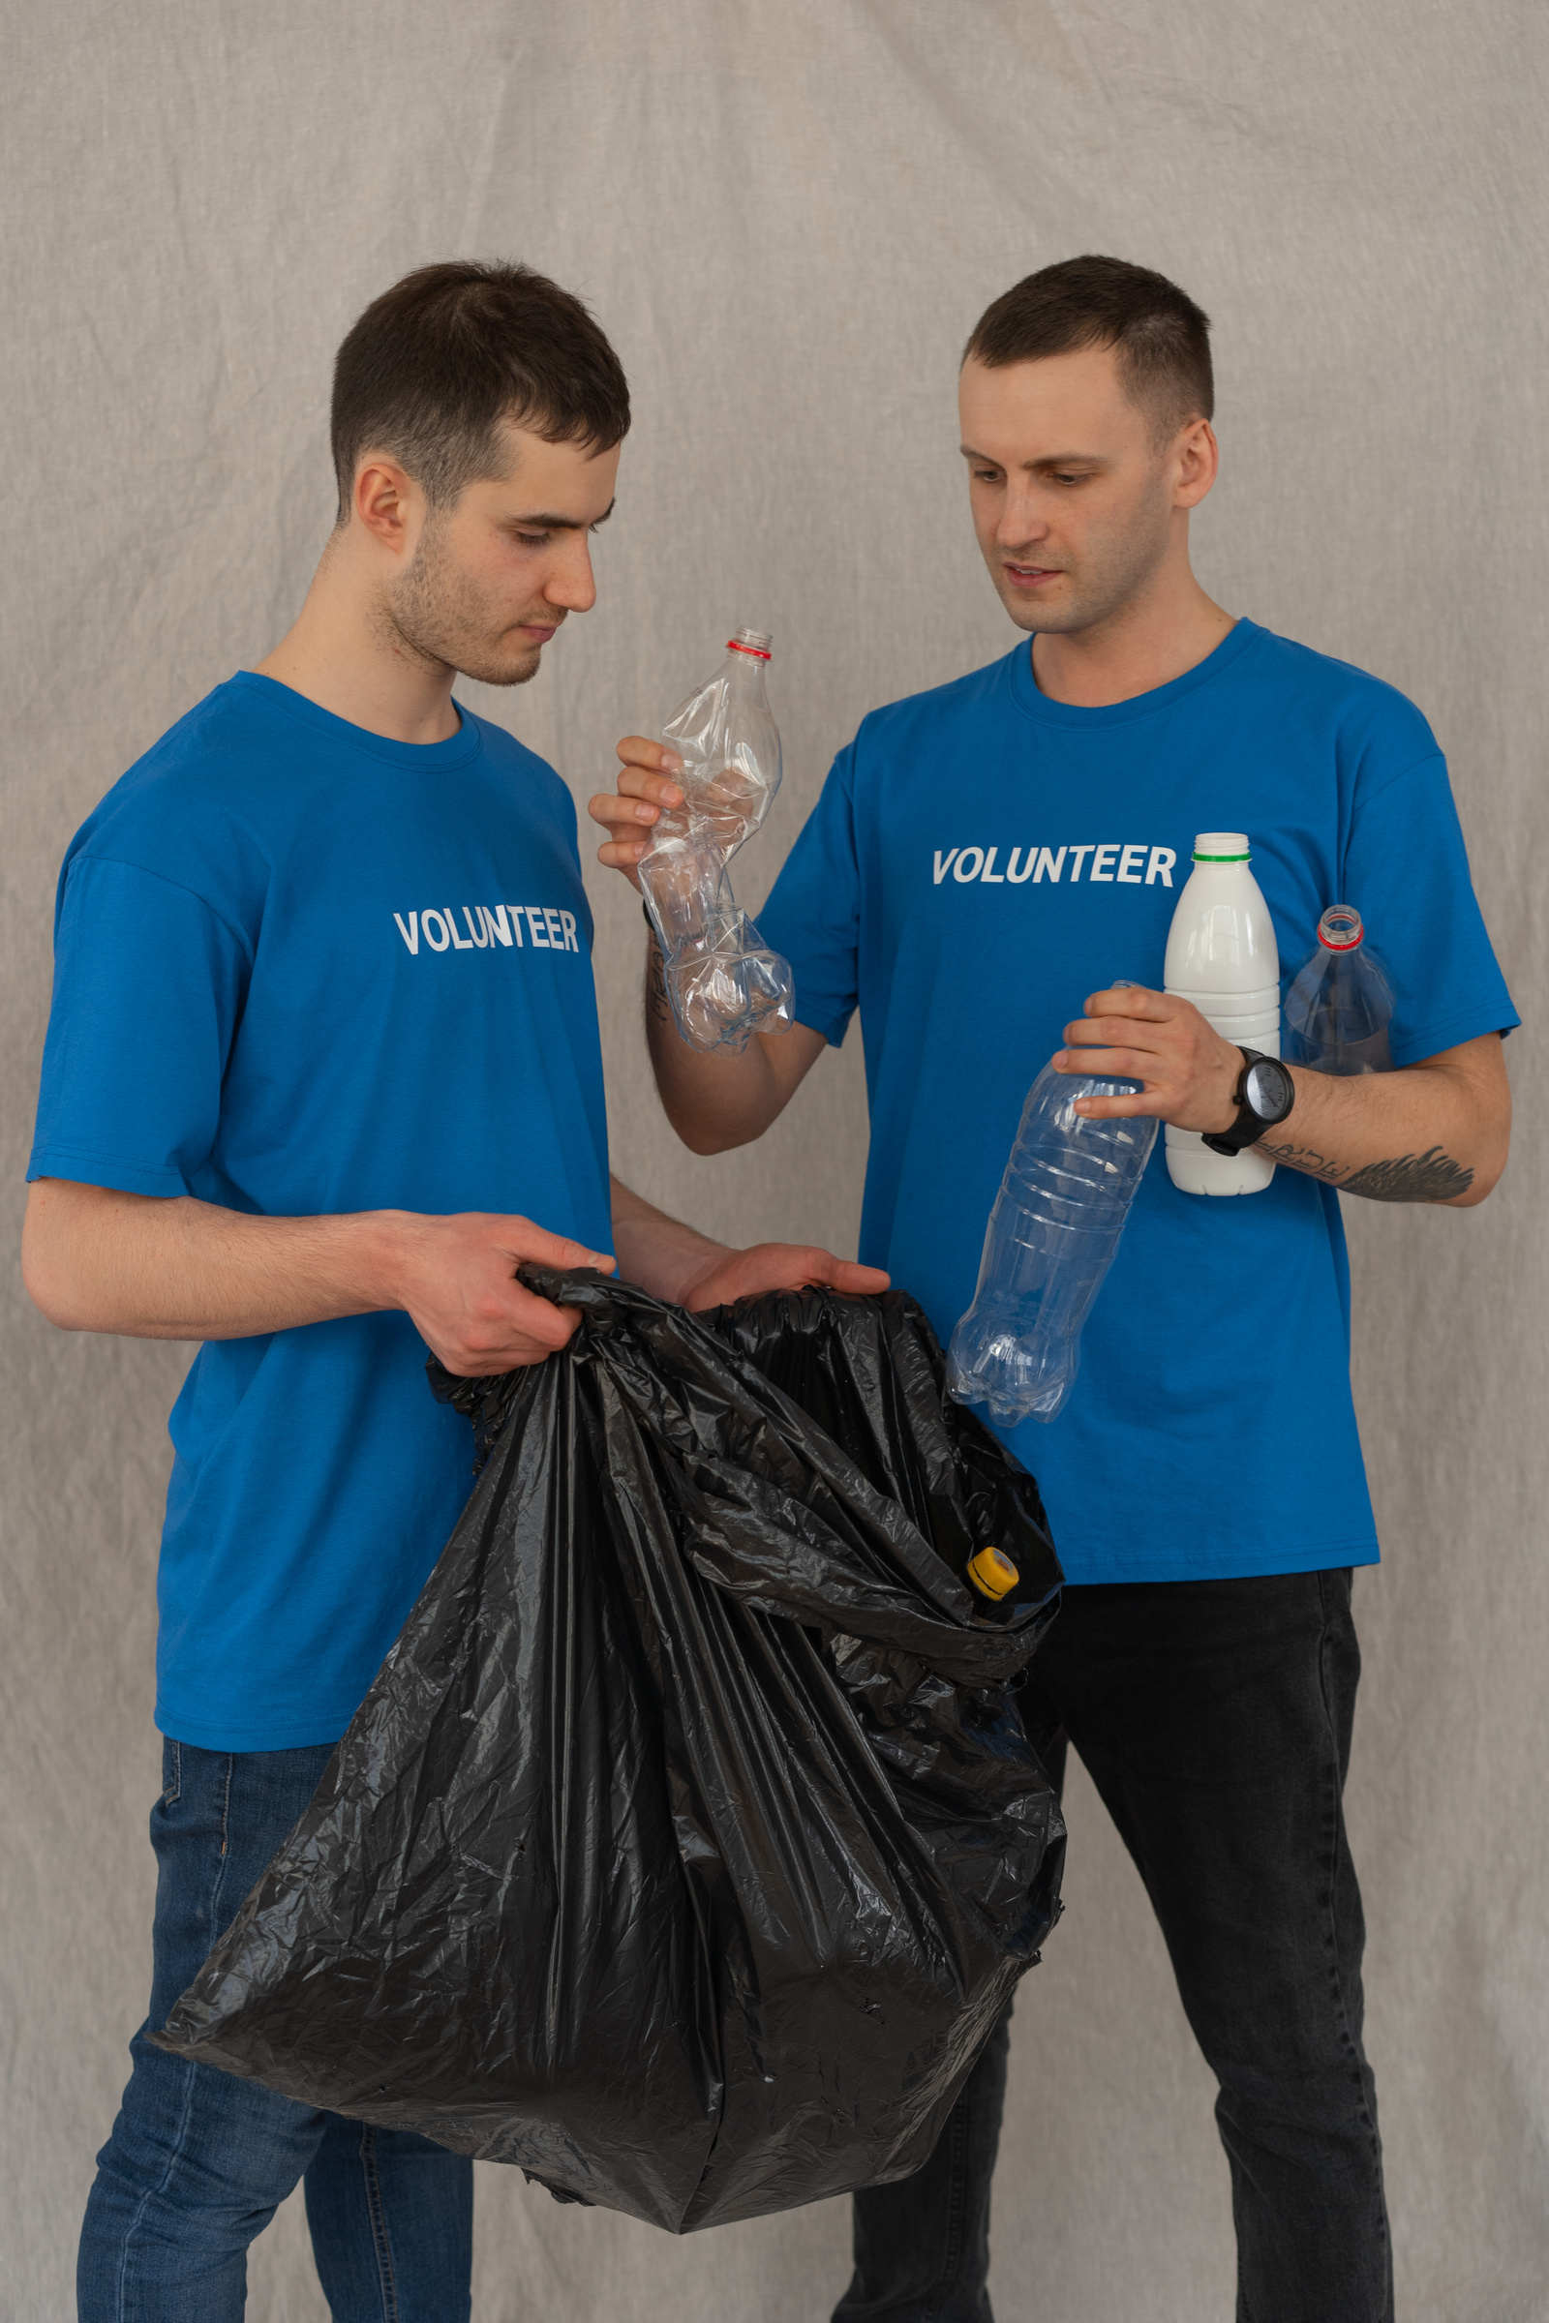
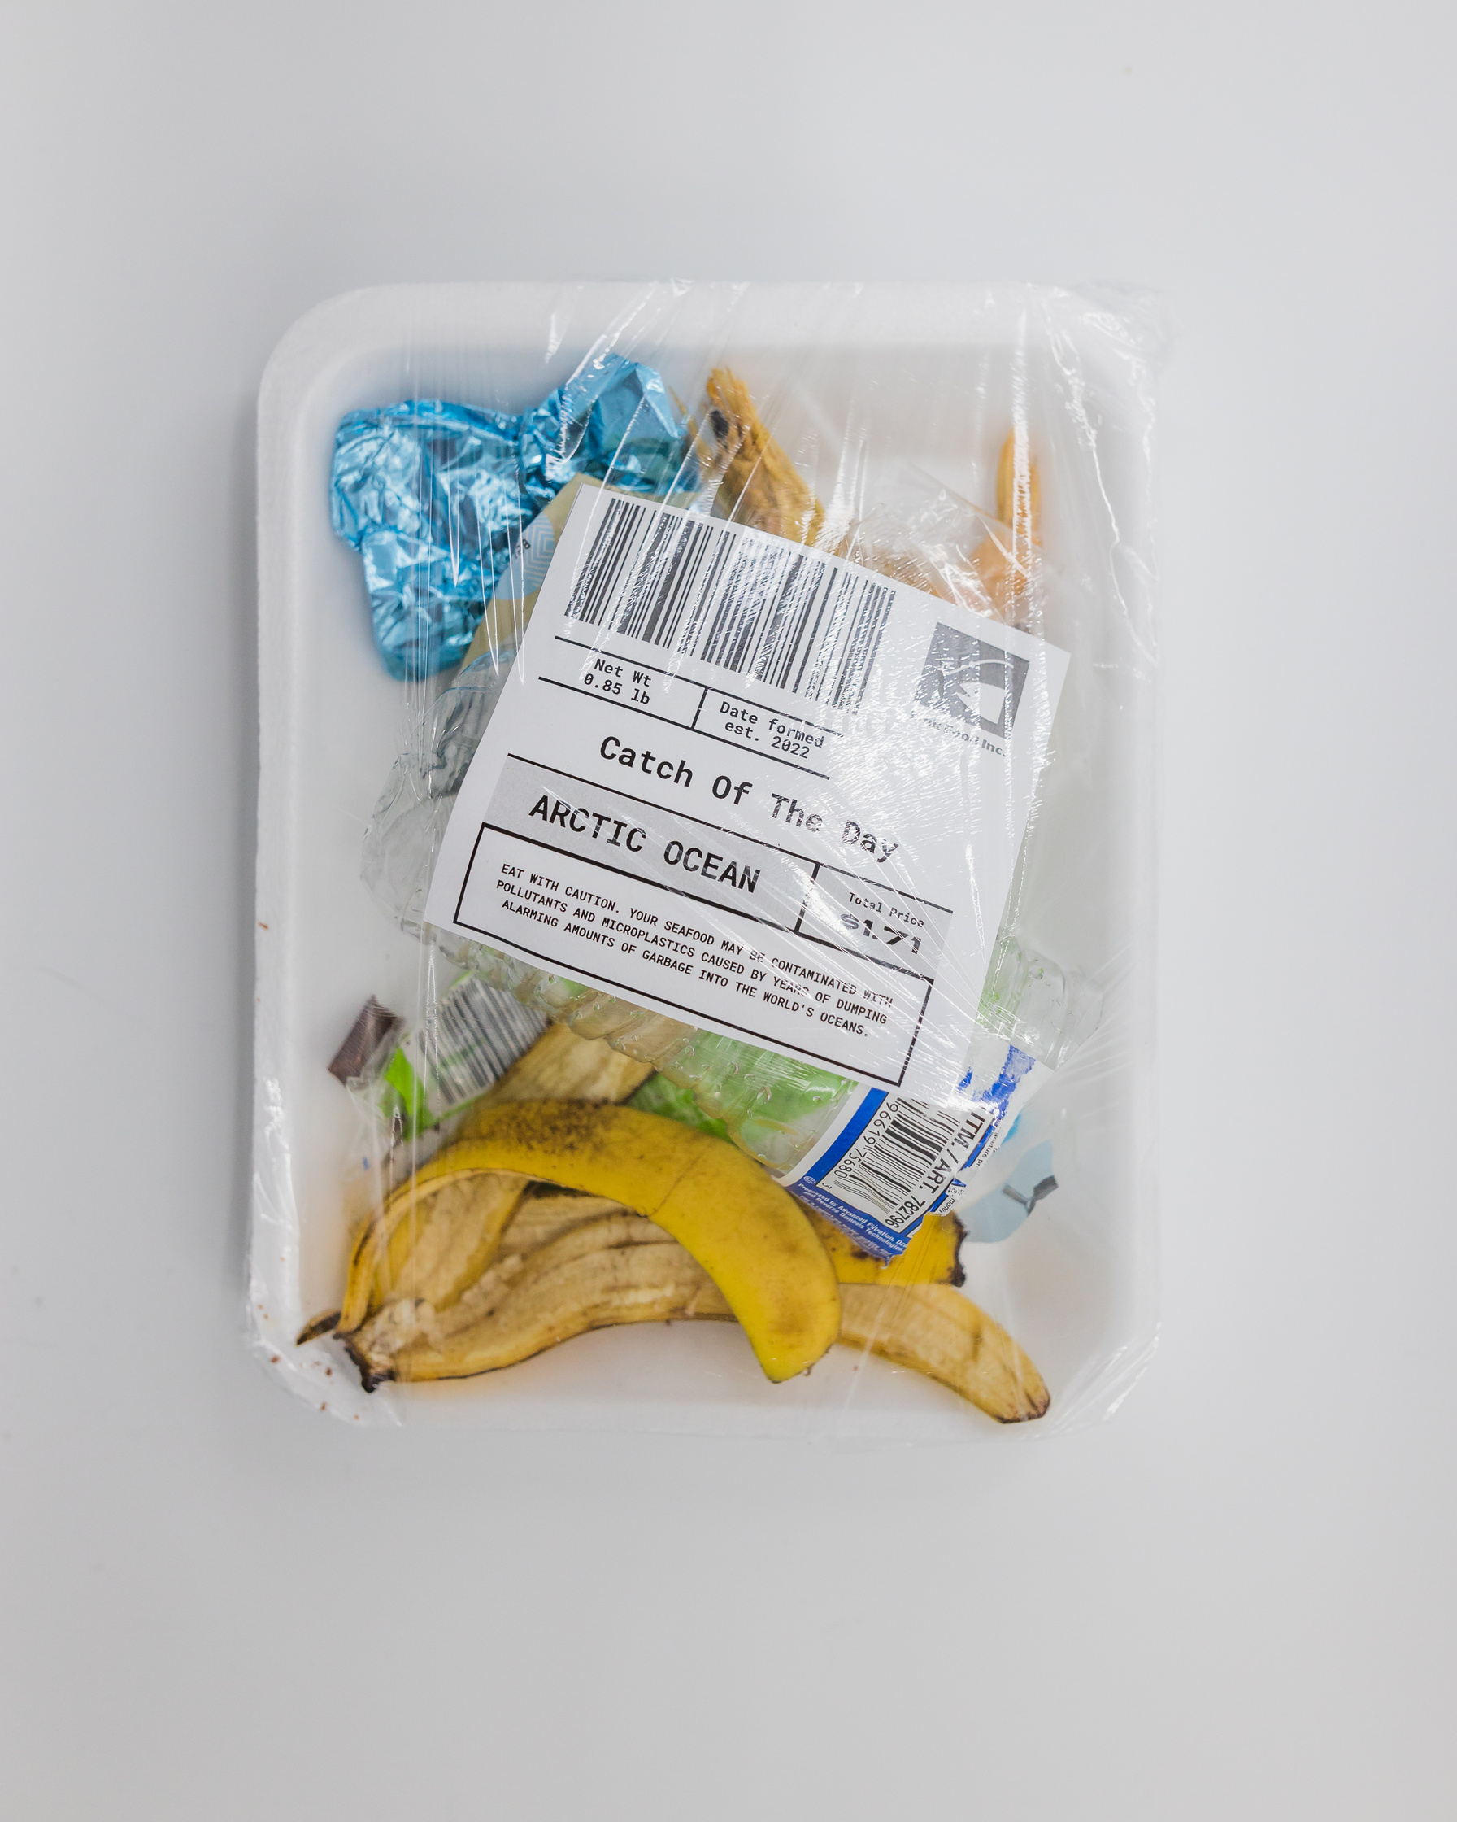




Thank You
BE PART OF THE CHANGE—CHOOSE WISELY, REDUCE PLASTIC, AND PROTECT OUR PLANET.
LICERIA & CO.
GET IN TOUCH
+123-456-7890
WWW.REALLYGREATSITE.COM
HELLO@REALLYGREATSITE.COM
123 ANYWHERE ST., ANY CITY, ST 12345

